Slide 1
THANKS A LOT, MR MARK!
THANKS A LOT, MR CHARLIE!
14th FEBRUARY 2024
IC SISSA TRECASALI
SISSA and TRECASALI PRIMARY SCHOOL

Slide 2
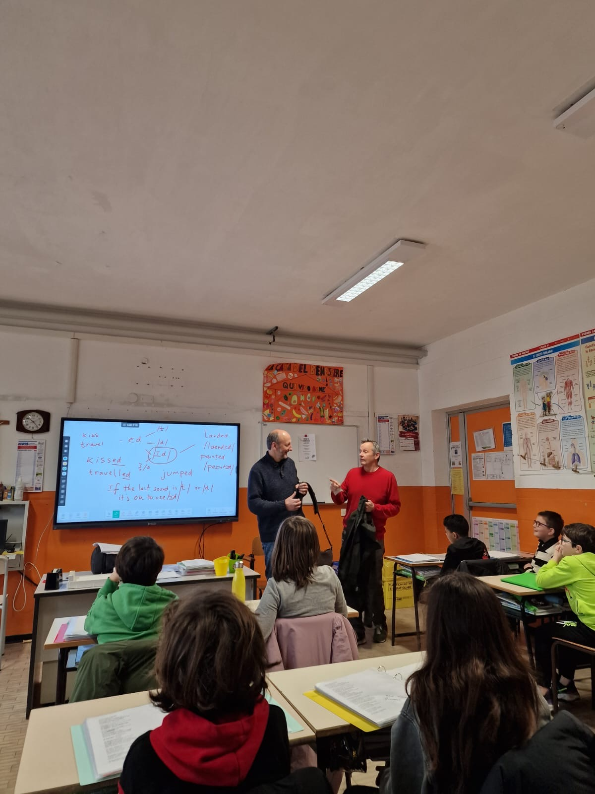
IMAGES OF AN INTERESTING ENGLISH LESSON
WITH MR CHARLIE AND MR MARK...

Slide 3
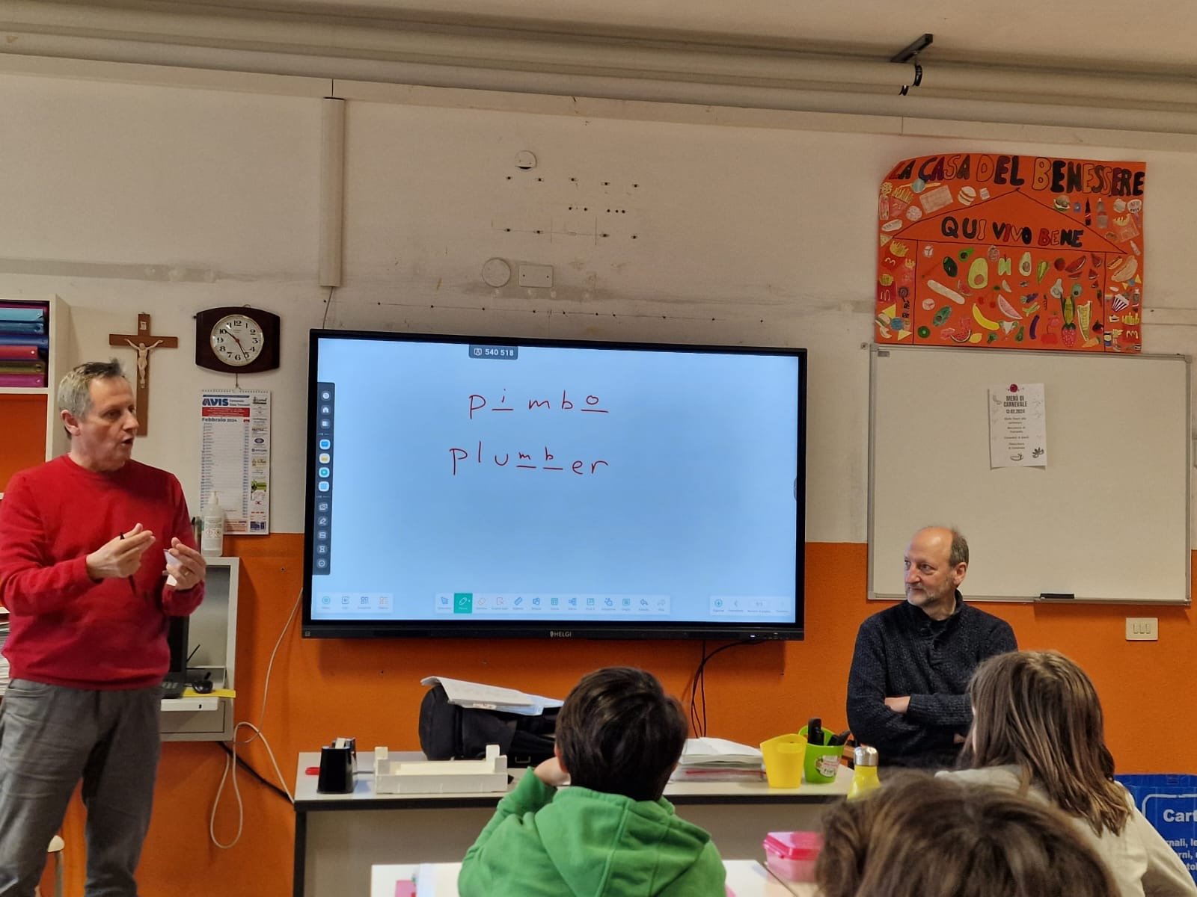
MR CHARLIE INTRODUCE MR MARK TO THE CLASS...

Slide 4
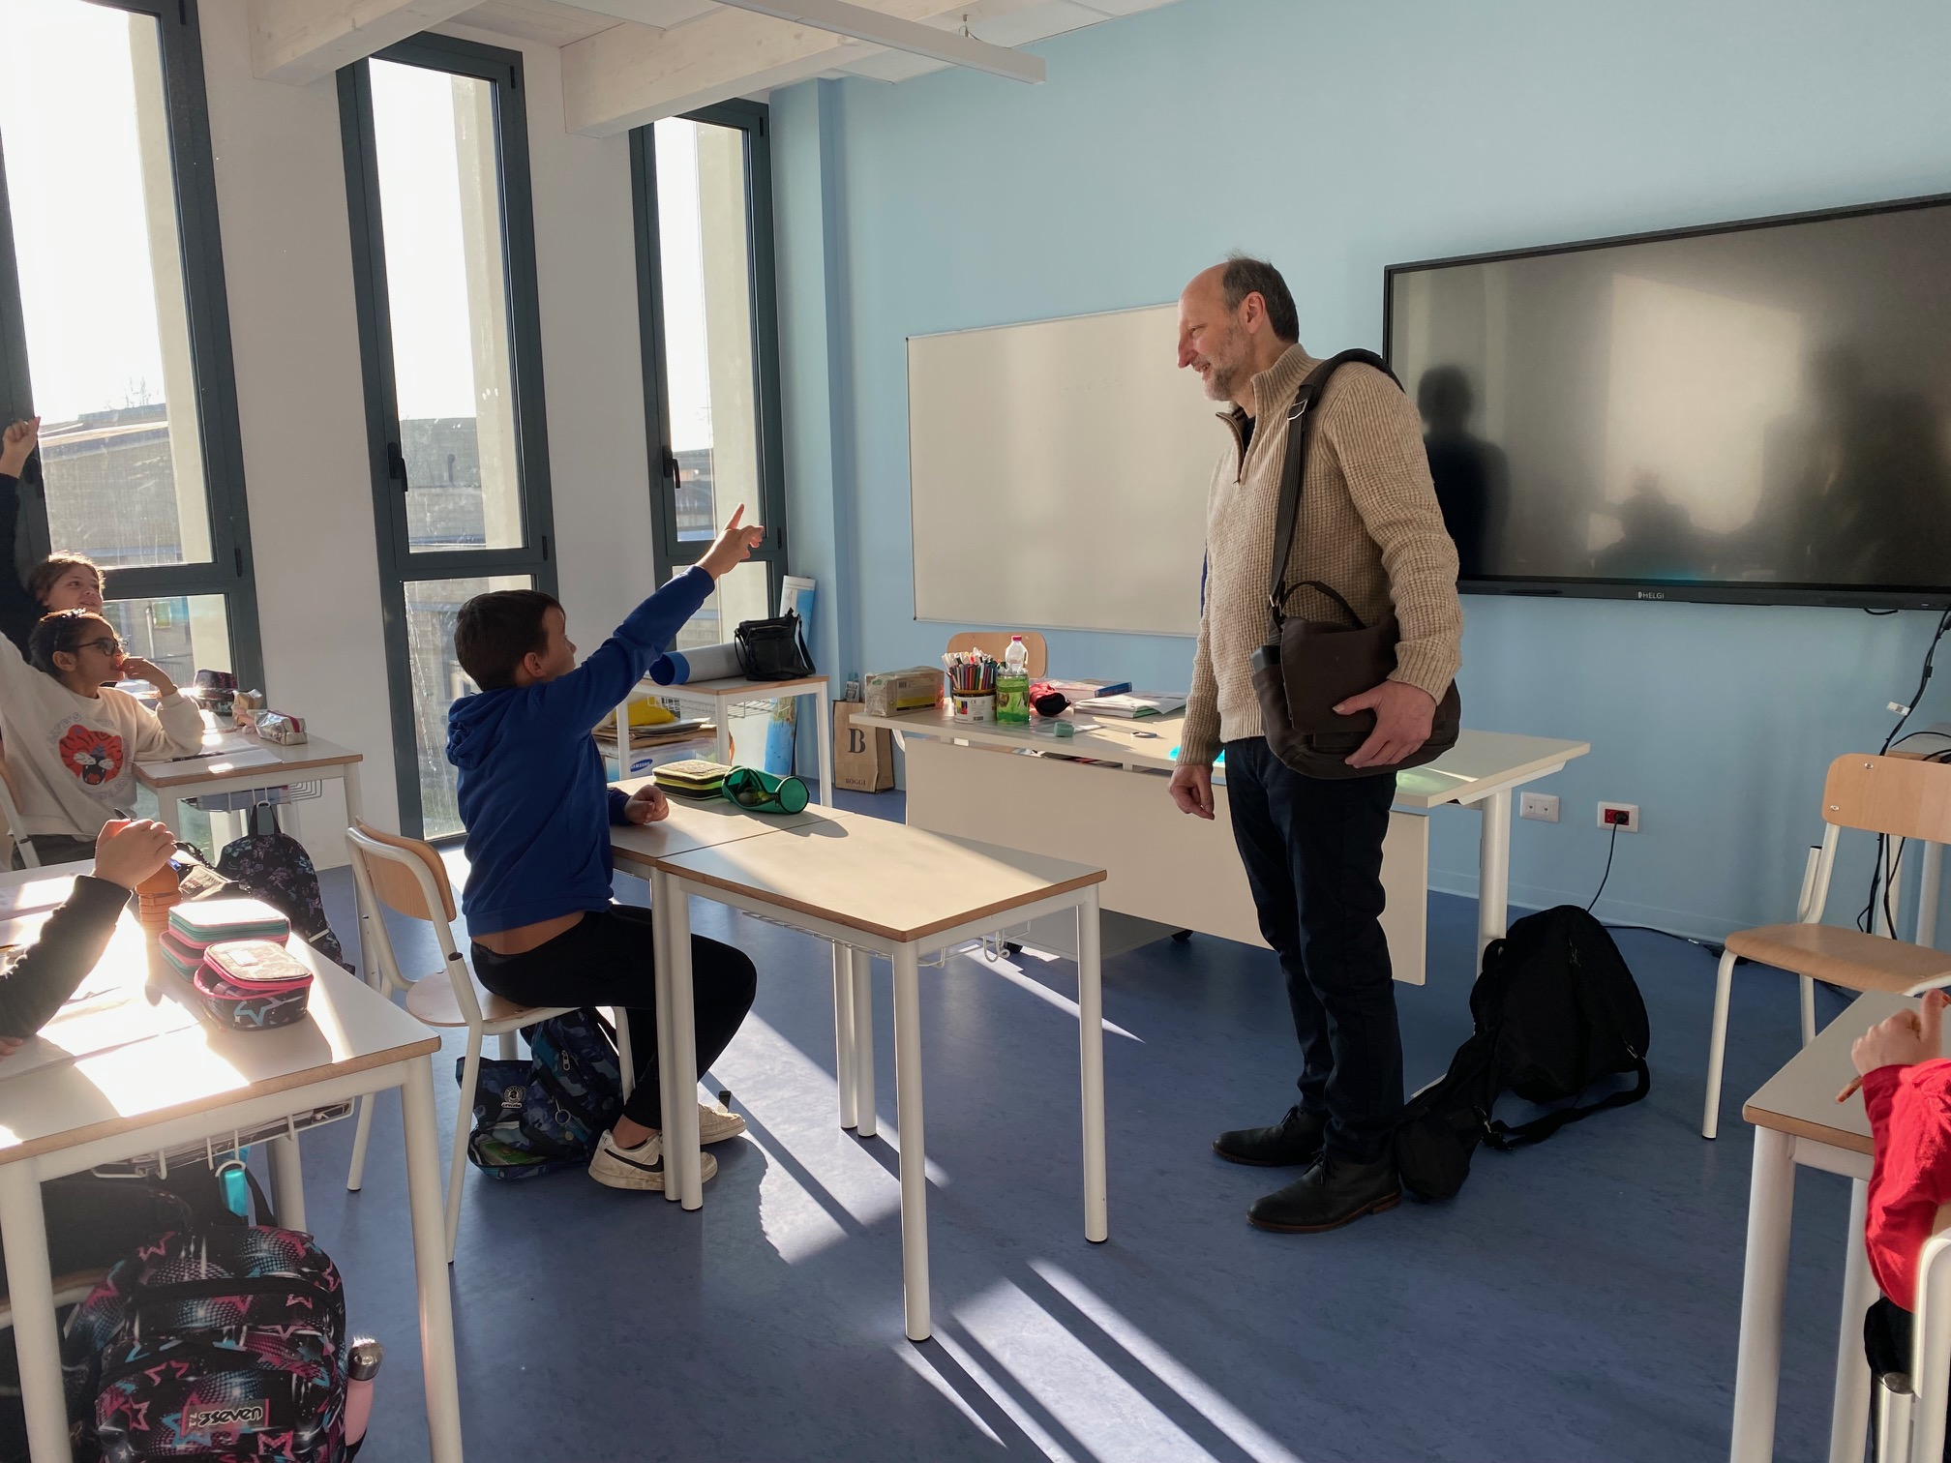
CHILDREN INTERVIEW MR MARK...

Slide 5
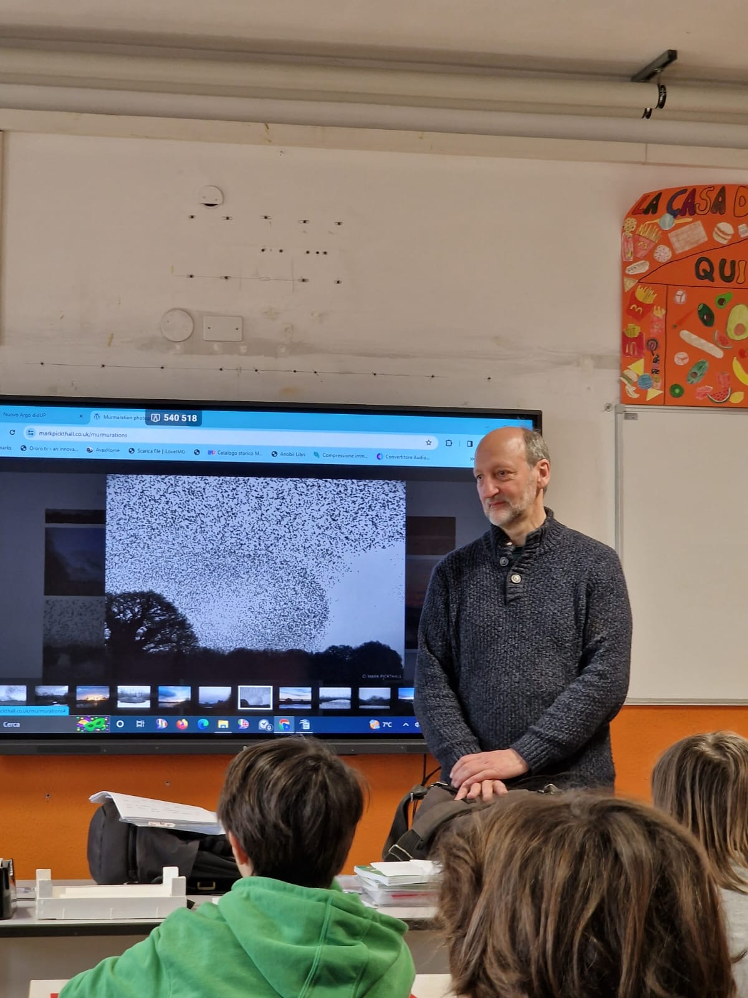
MR MARK IS A VERY GOOD PHOTOGRAPHER!

Slide 6
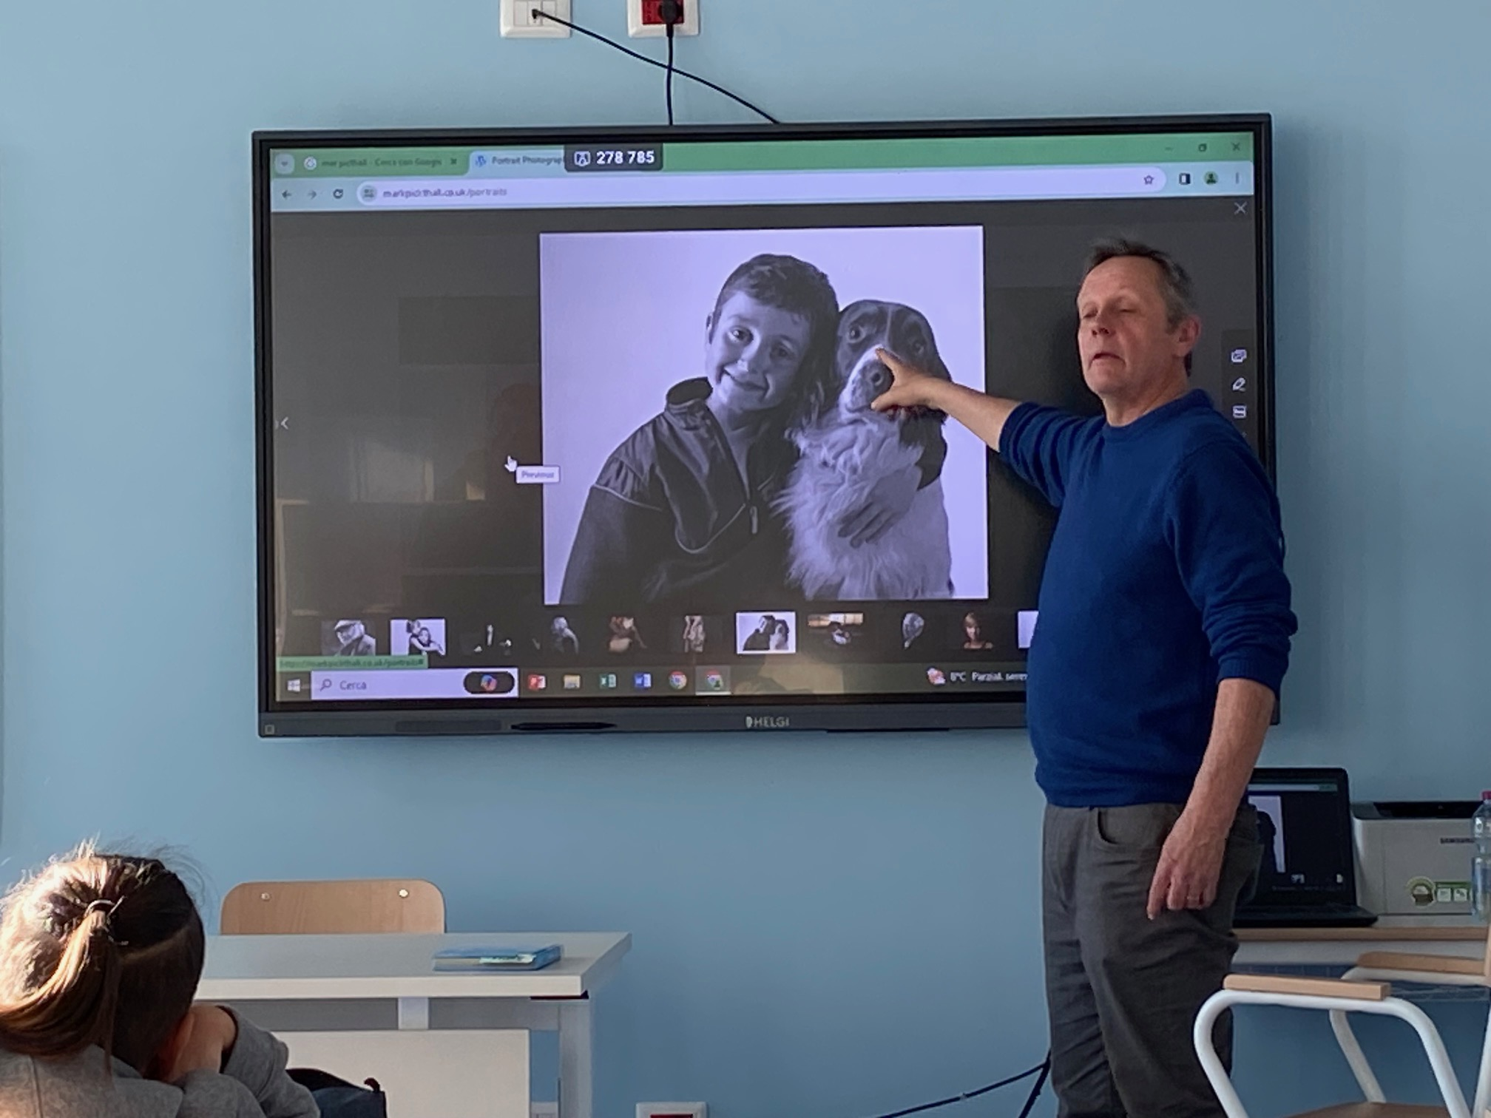

Slide 7
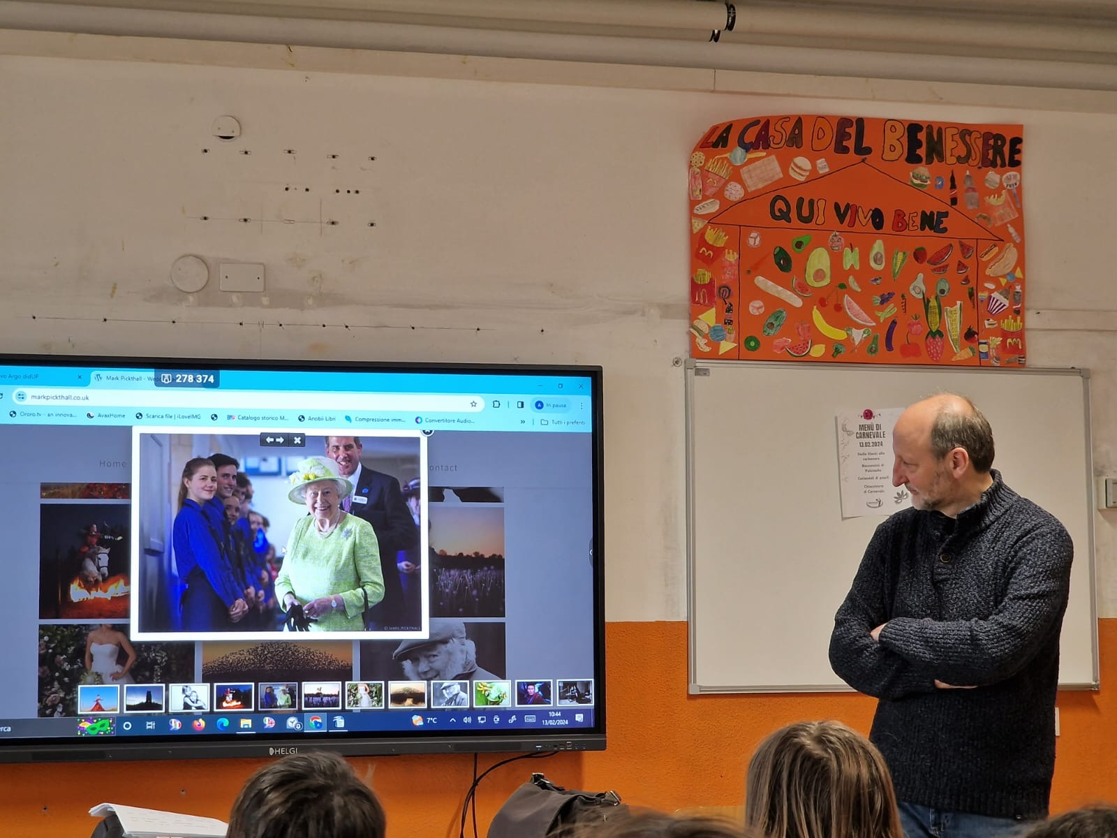

Slide 8
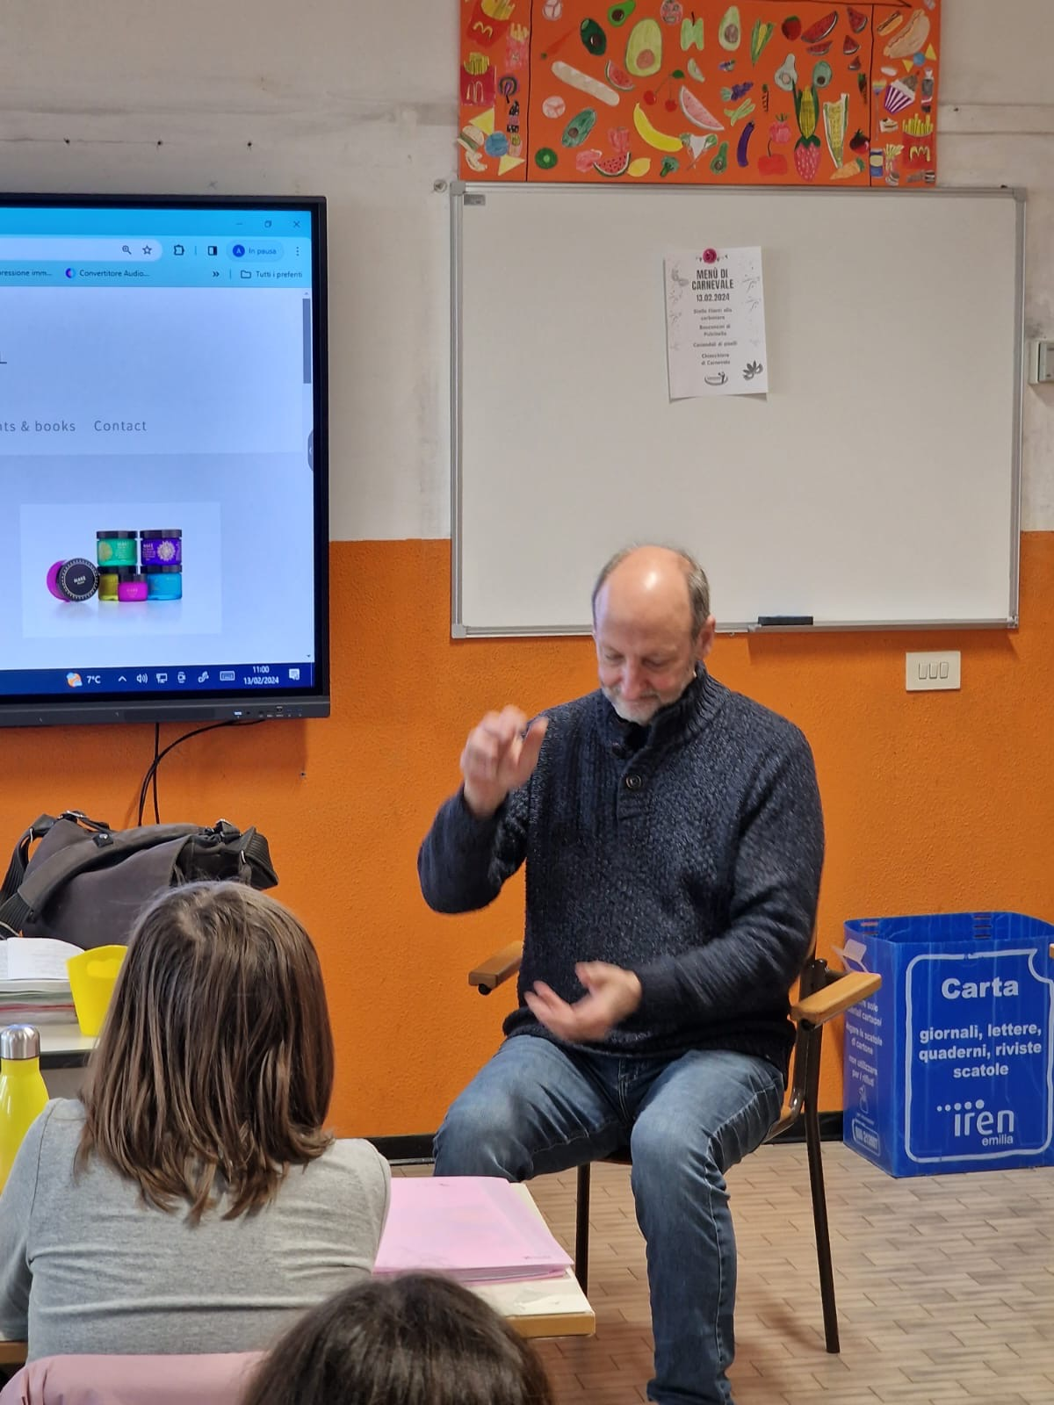
MR MARK IS A VERY SKILLED POTTER!

Slide 9
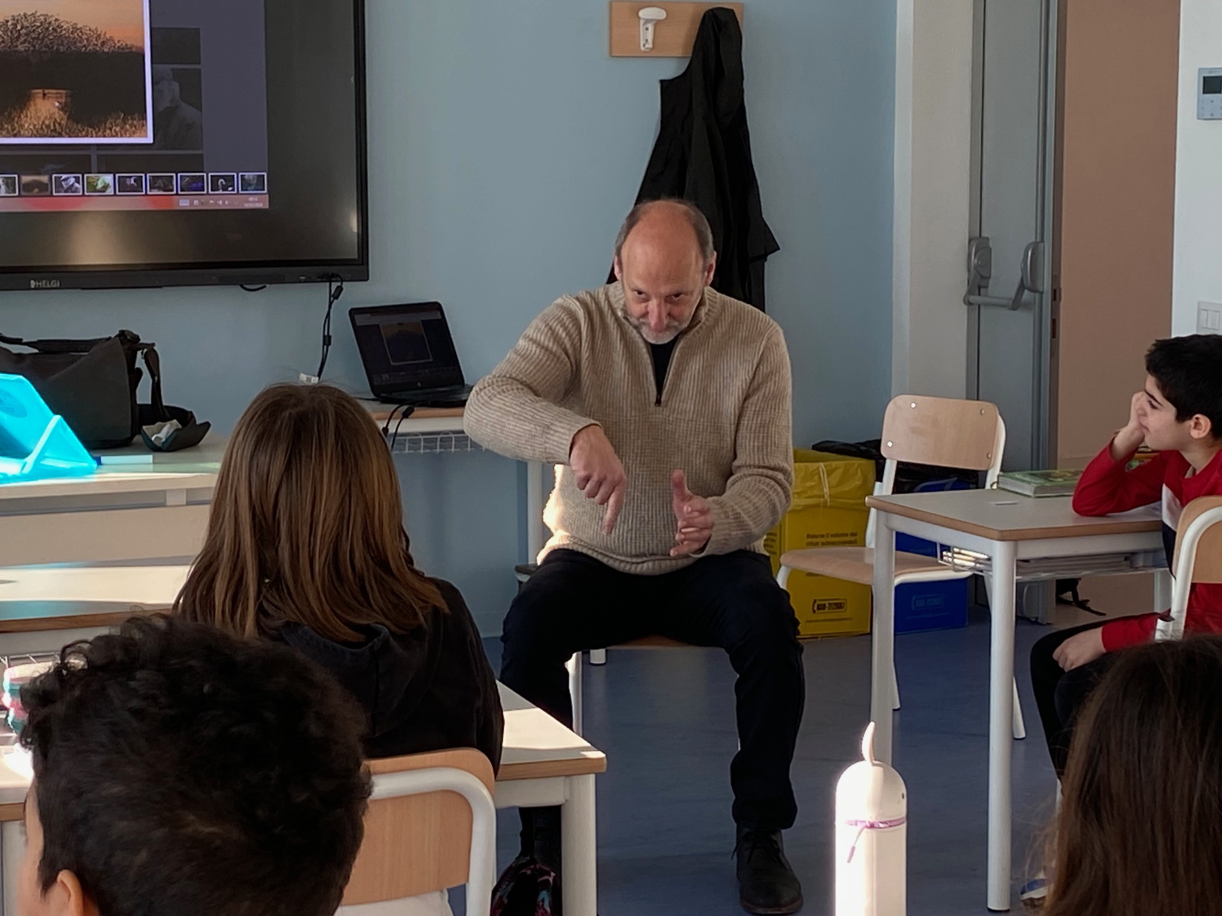

Slide 10
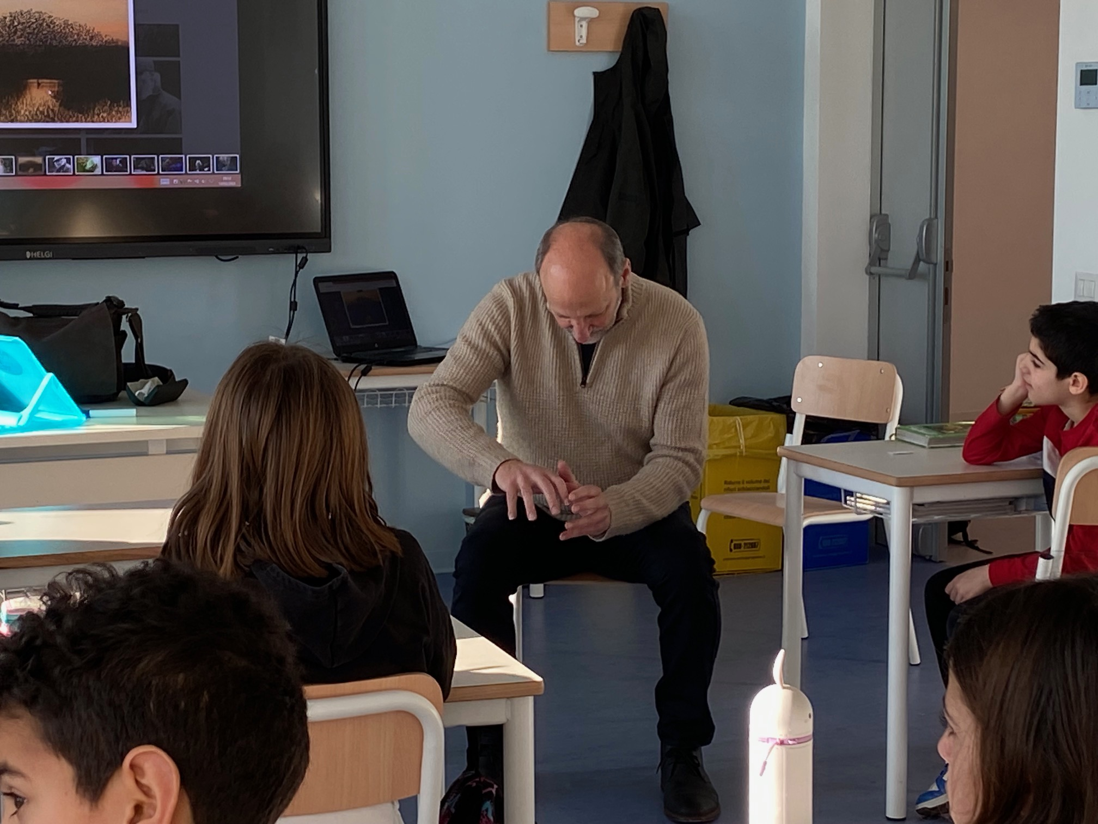

Slide 11
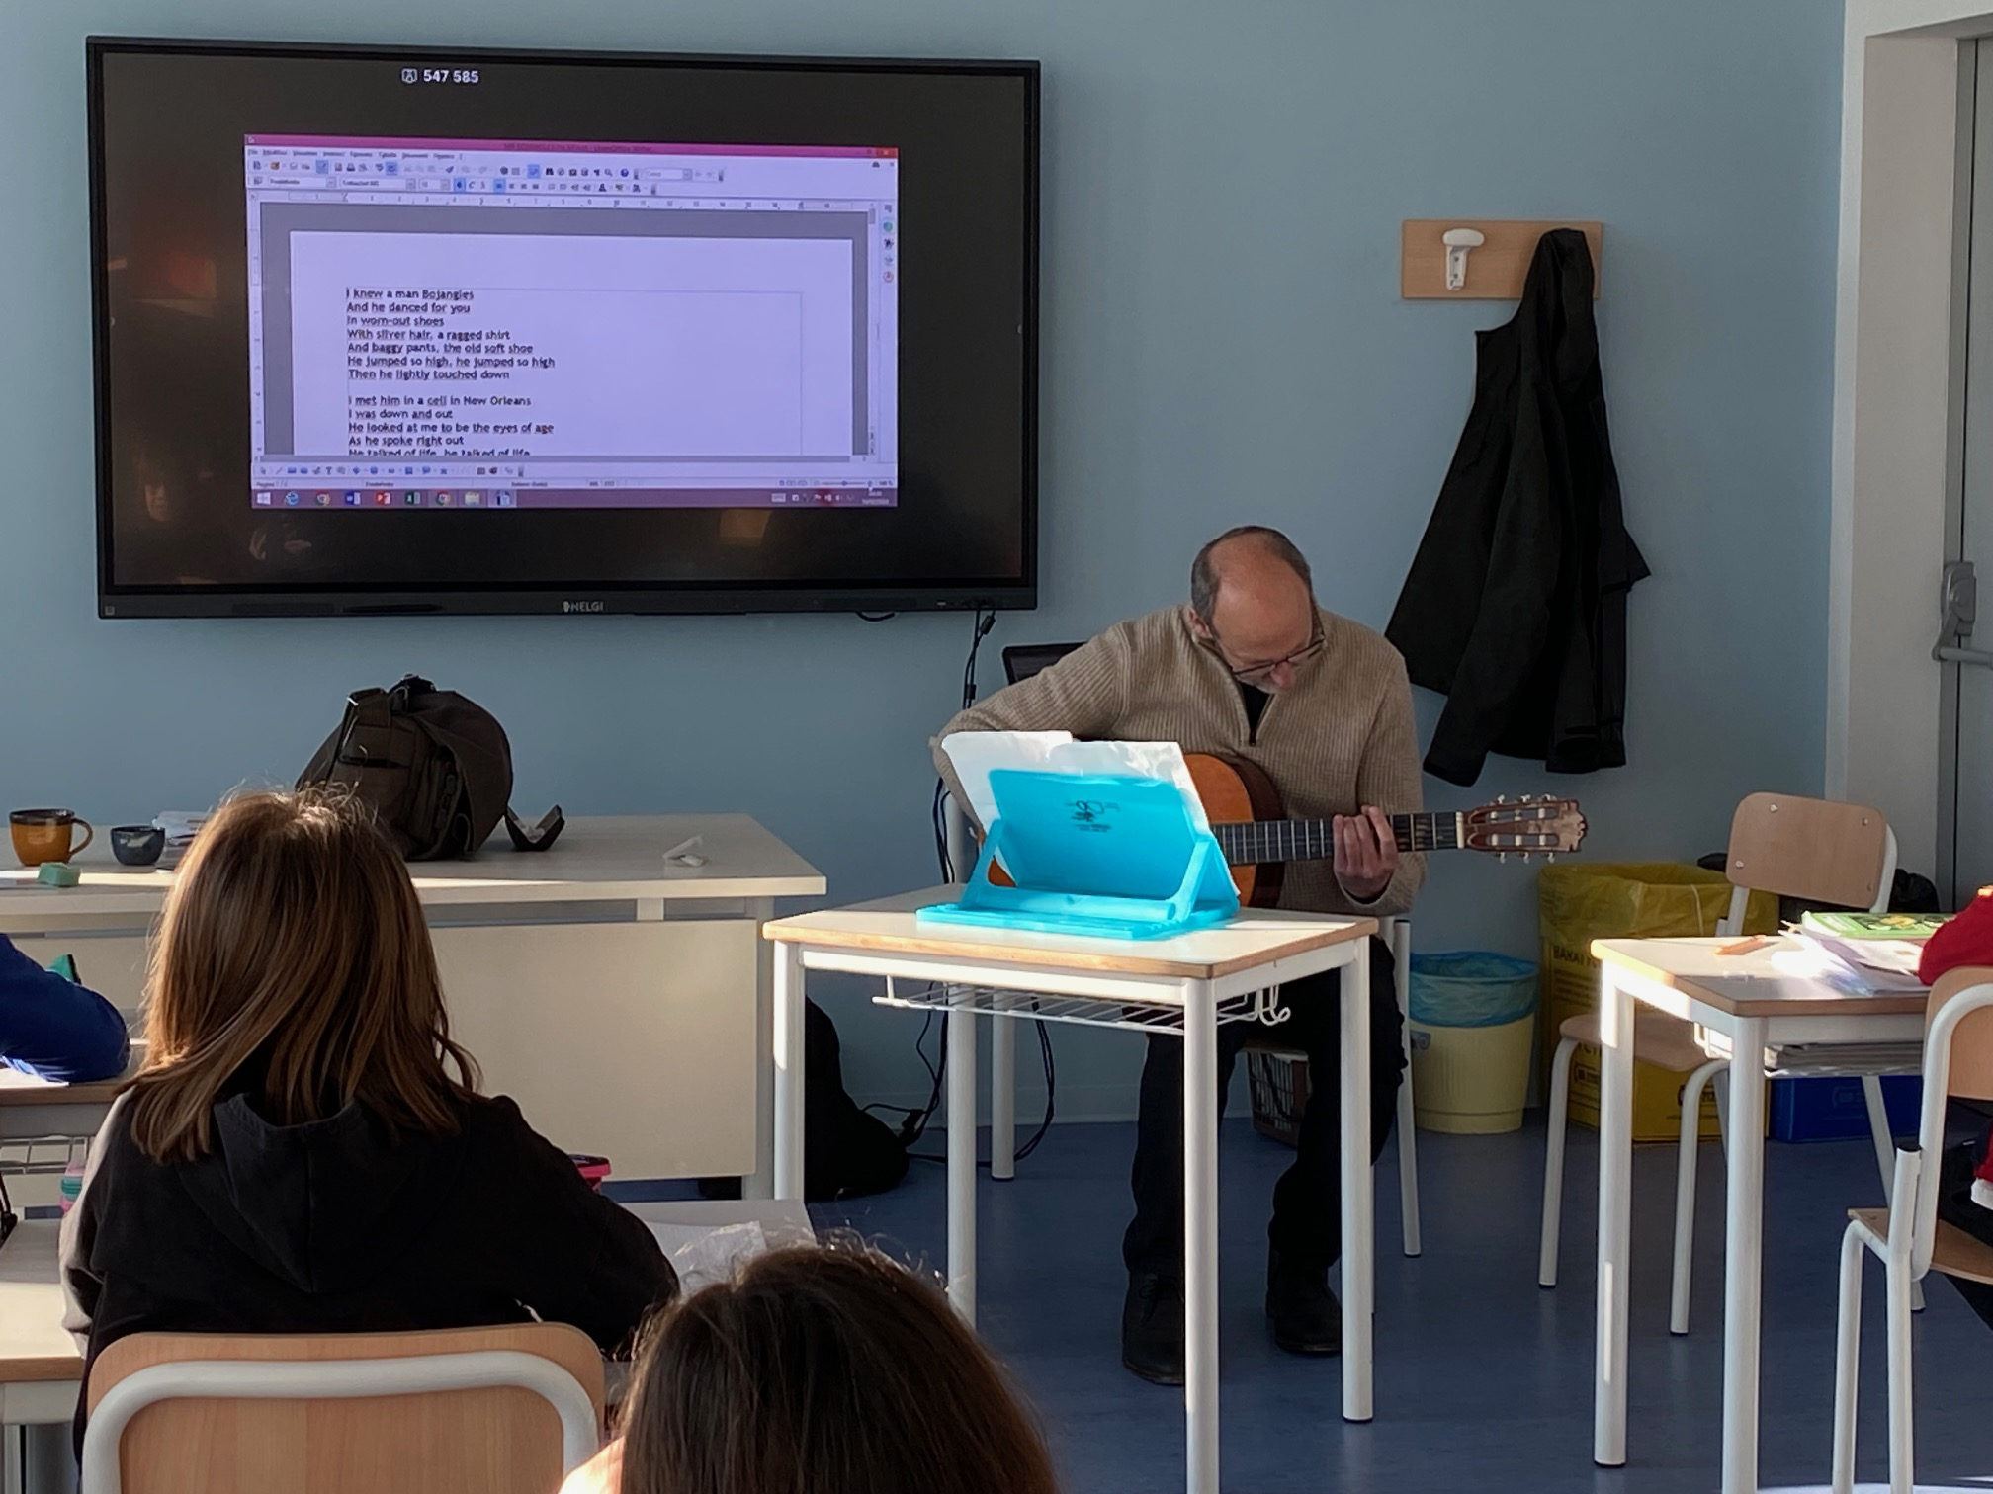
MR MARK IS A MARVELLOUS SINGER!

Slide 12
Mr Bojangles
I knew a man Bojangles and he danced for you
In worn out shoes
With silver hair, a ragged shirt and baggy pants
The old soft shoe
He jumped so high
Jumped so high
Then he'd lightly touch down
Mr Bojangles
Mr Bojangles
Mr Bojangles
I met him in a cell in New Orleans, I was
Down and out
He looked to me to be the eyes of age
As he spoke right out
He talked of life
Talked of life
He laughed, slapped his leg instead
He said the name Bojangles and he danced a lick
Across the cell
He grabbed his pants for a better stance
Ooh, he jumped so high
He clicked his heels
He let go a laugh
He let go a laugh
Shook back his clothes all around
Mr Bojangles
Mr Bojangles
Mr Bojangles
We danced for those at minstrel shows and county fairs
Throughout the south
We spoke in tears of fifteen years
How his dog and him
They travelled about
His dog up and died
He up and died
After twenty years he still grieves
They said I dance now at every chance and honky tonks
For drinks and tips
But most the time I spend behind these county bars
'Cause I drinks a bit
He shook his head and as he shook his head
I heard someone ask please
Mr Bojangles
Mr Bojangles
Mr Bojangles

Slide 13
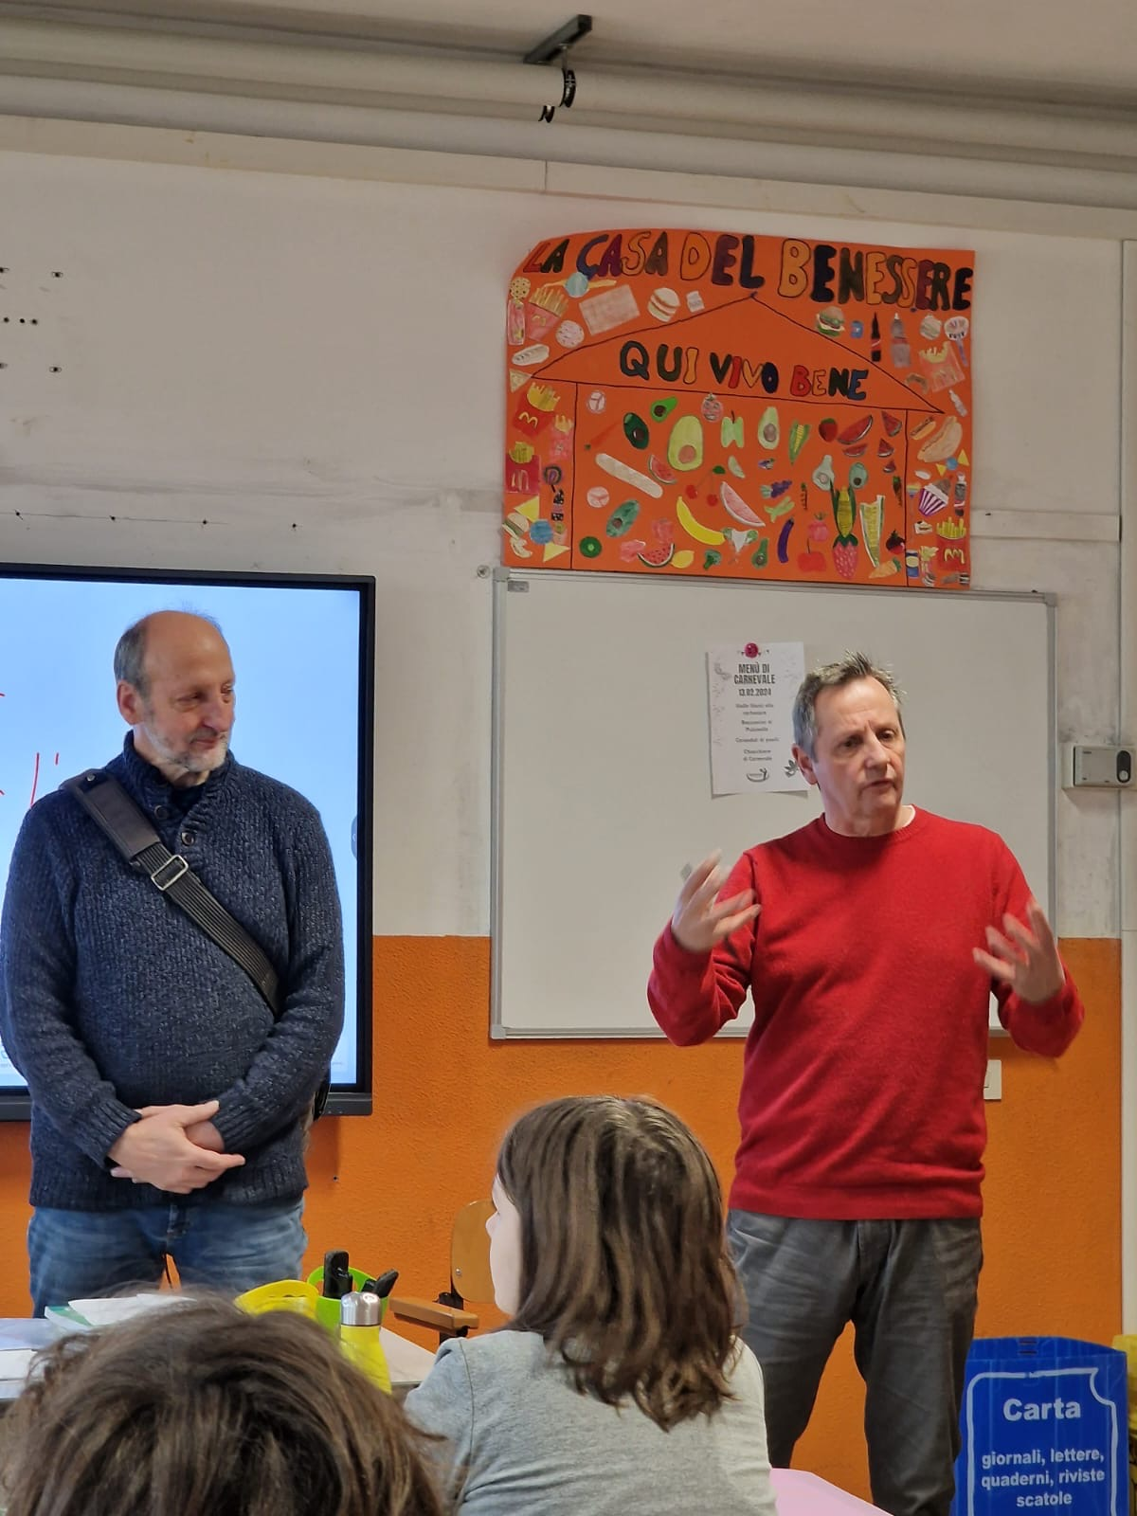
SURPRISE: MR MARK IS MR CHARLIE’S BROTHER!

Slide 14
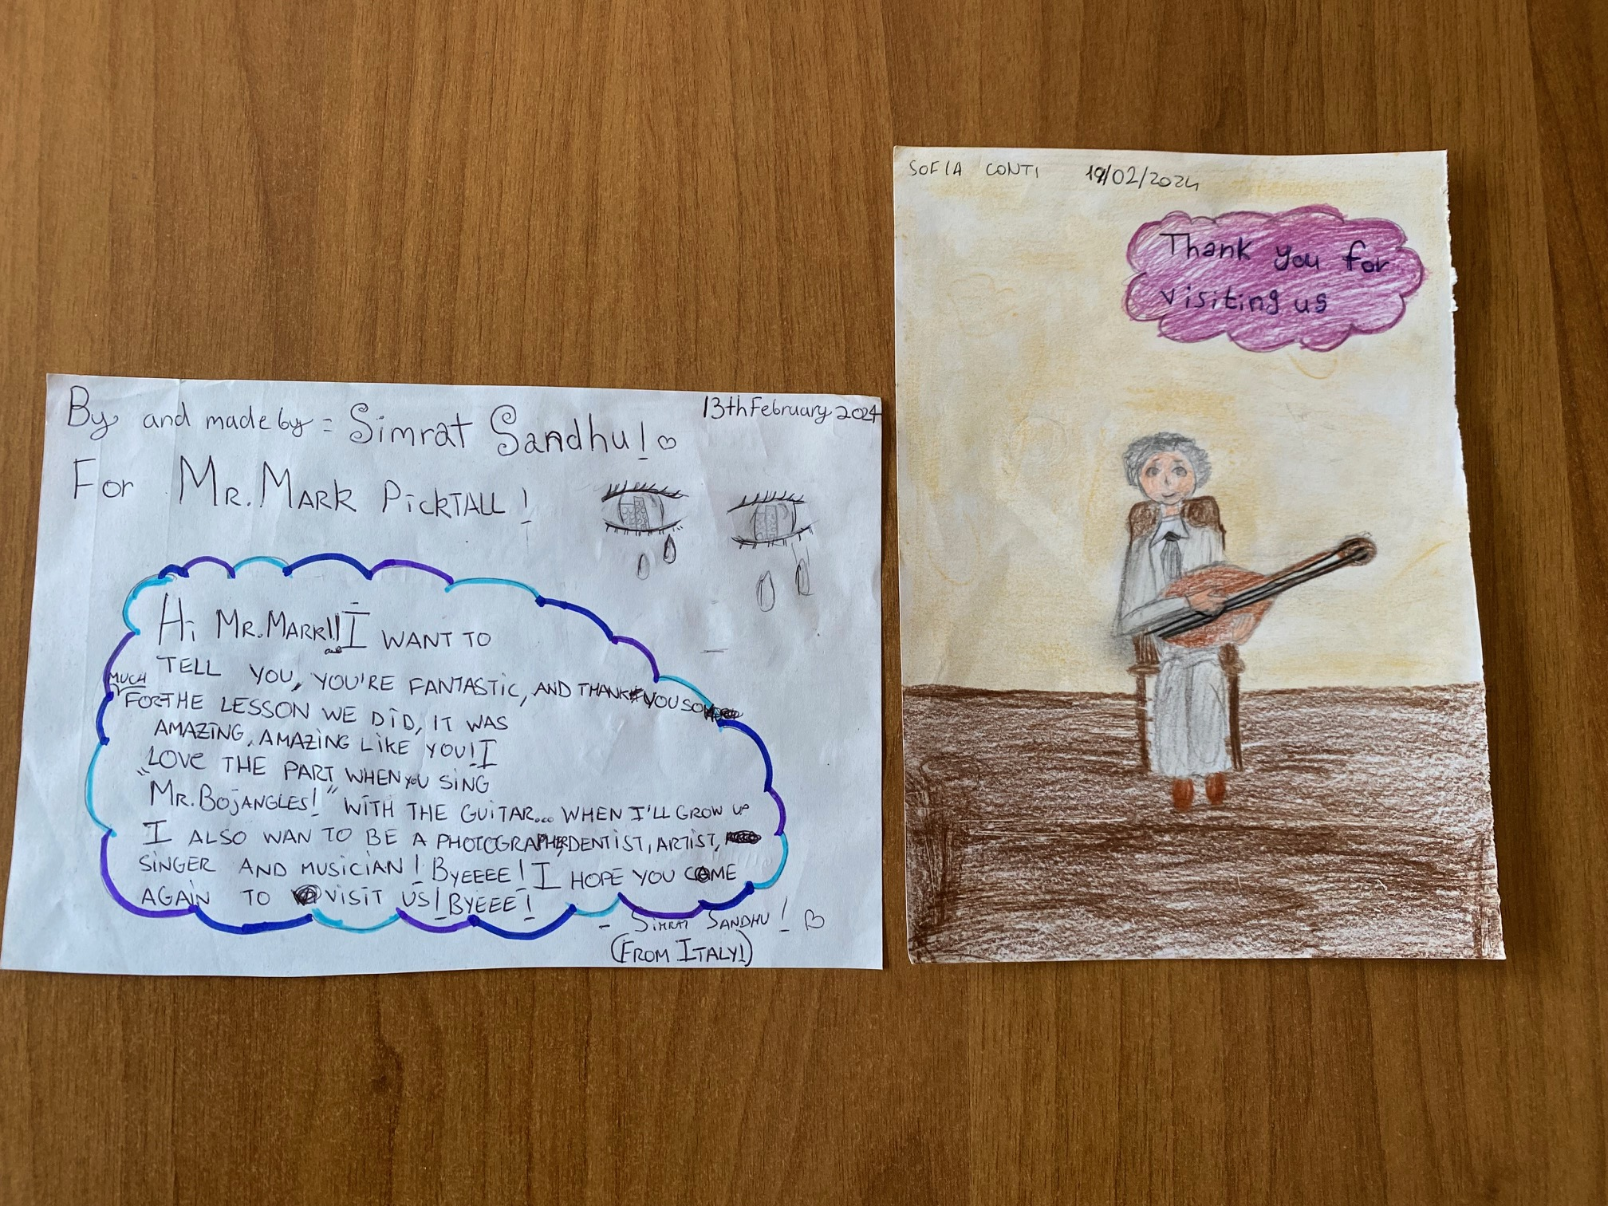
THANKS A LOT, MR MARK, FROM ALL OF US!
WE HOPE YOU’LL COME BACK TO SPEND WITH US SOME OF YOUR TIME!
THESE PICTURES ARE FOR YOU!

Slide 15
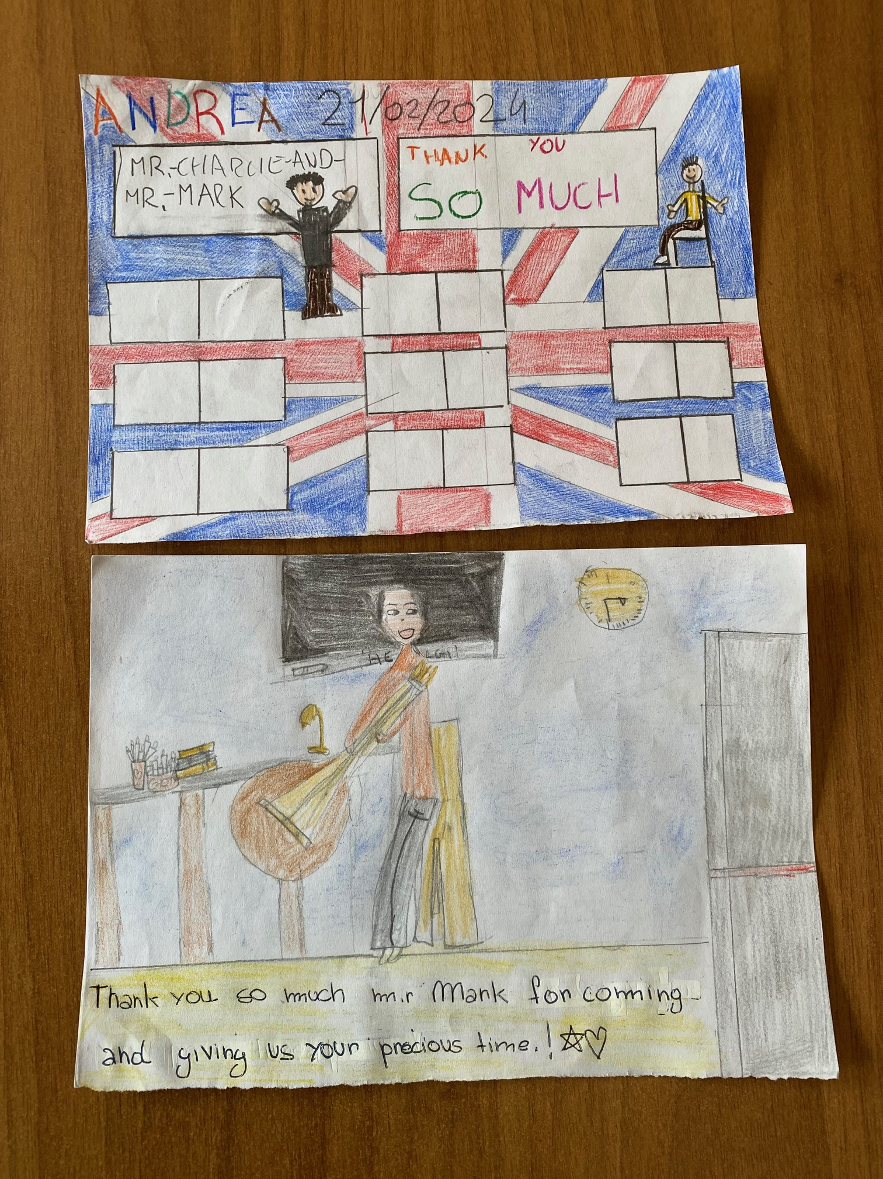

Slide 16
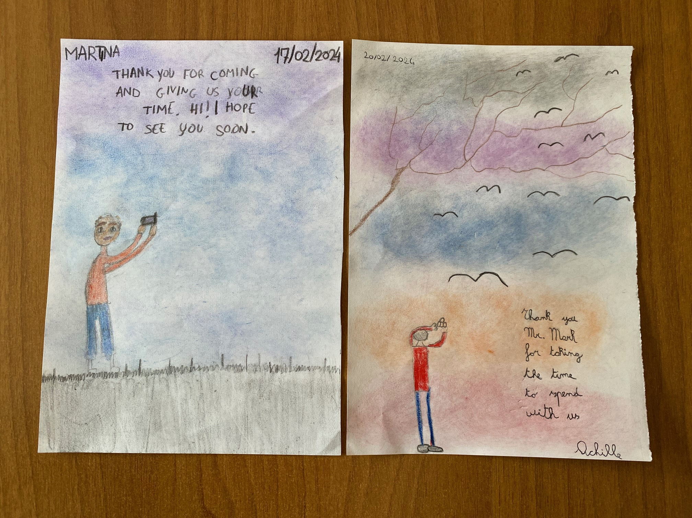

Slide 17
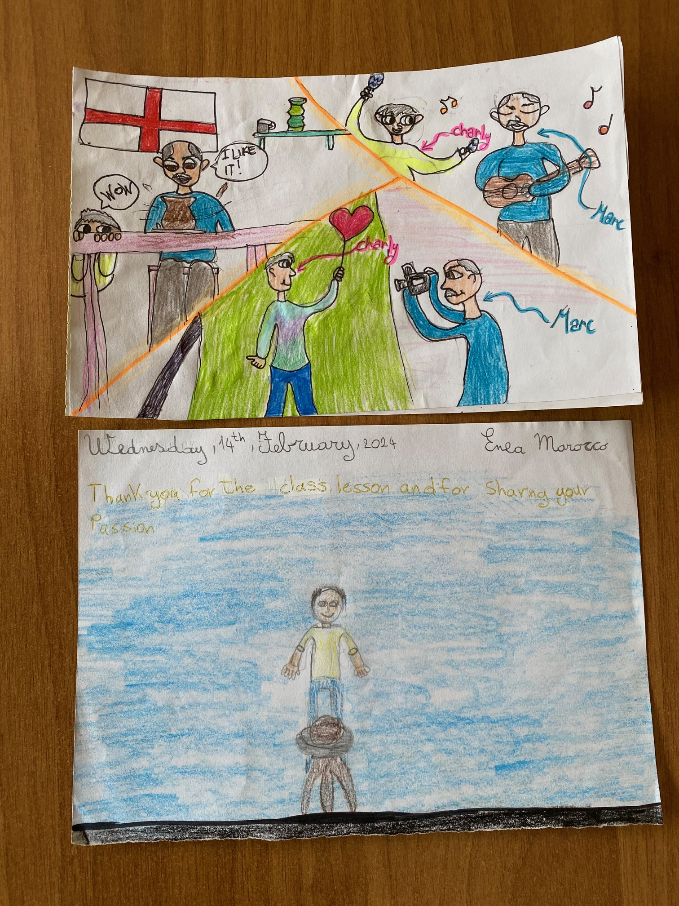

Slide 18
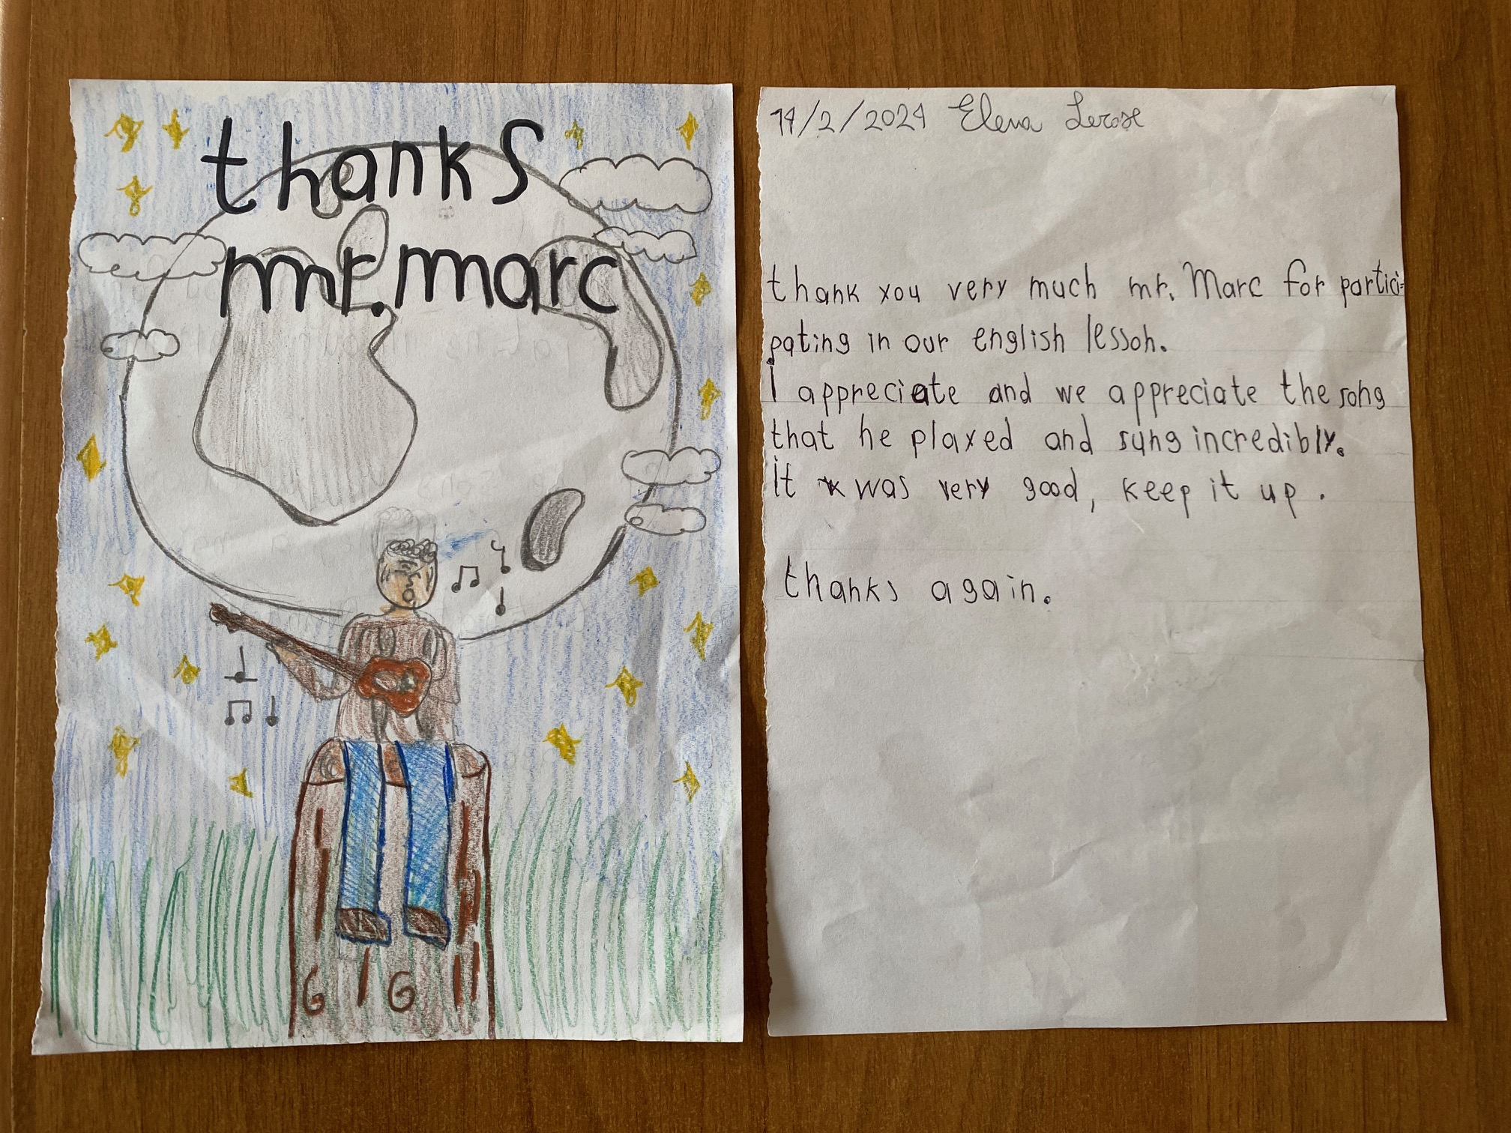

Slide 19
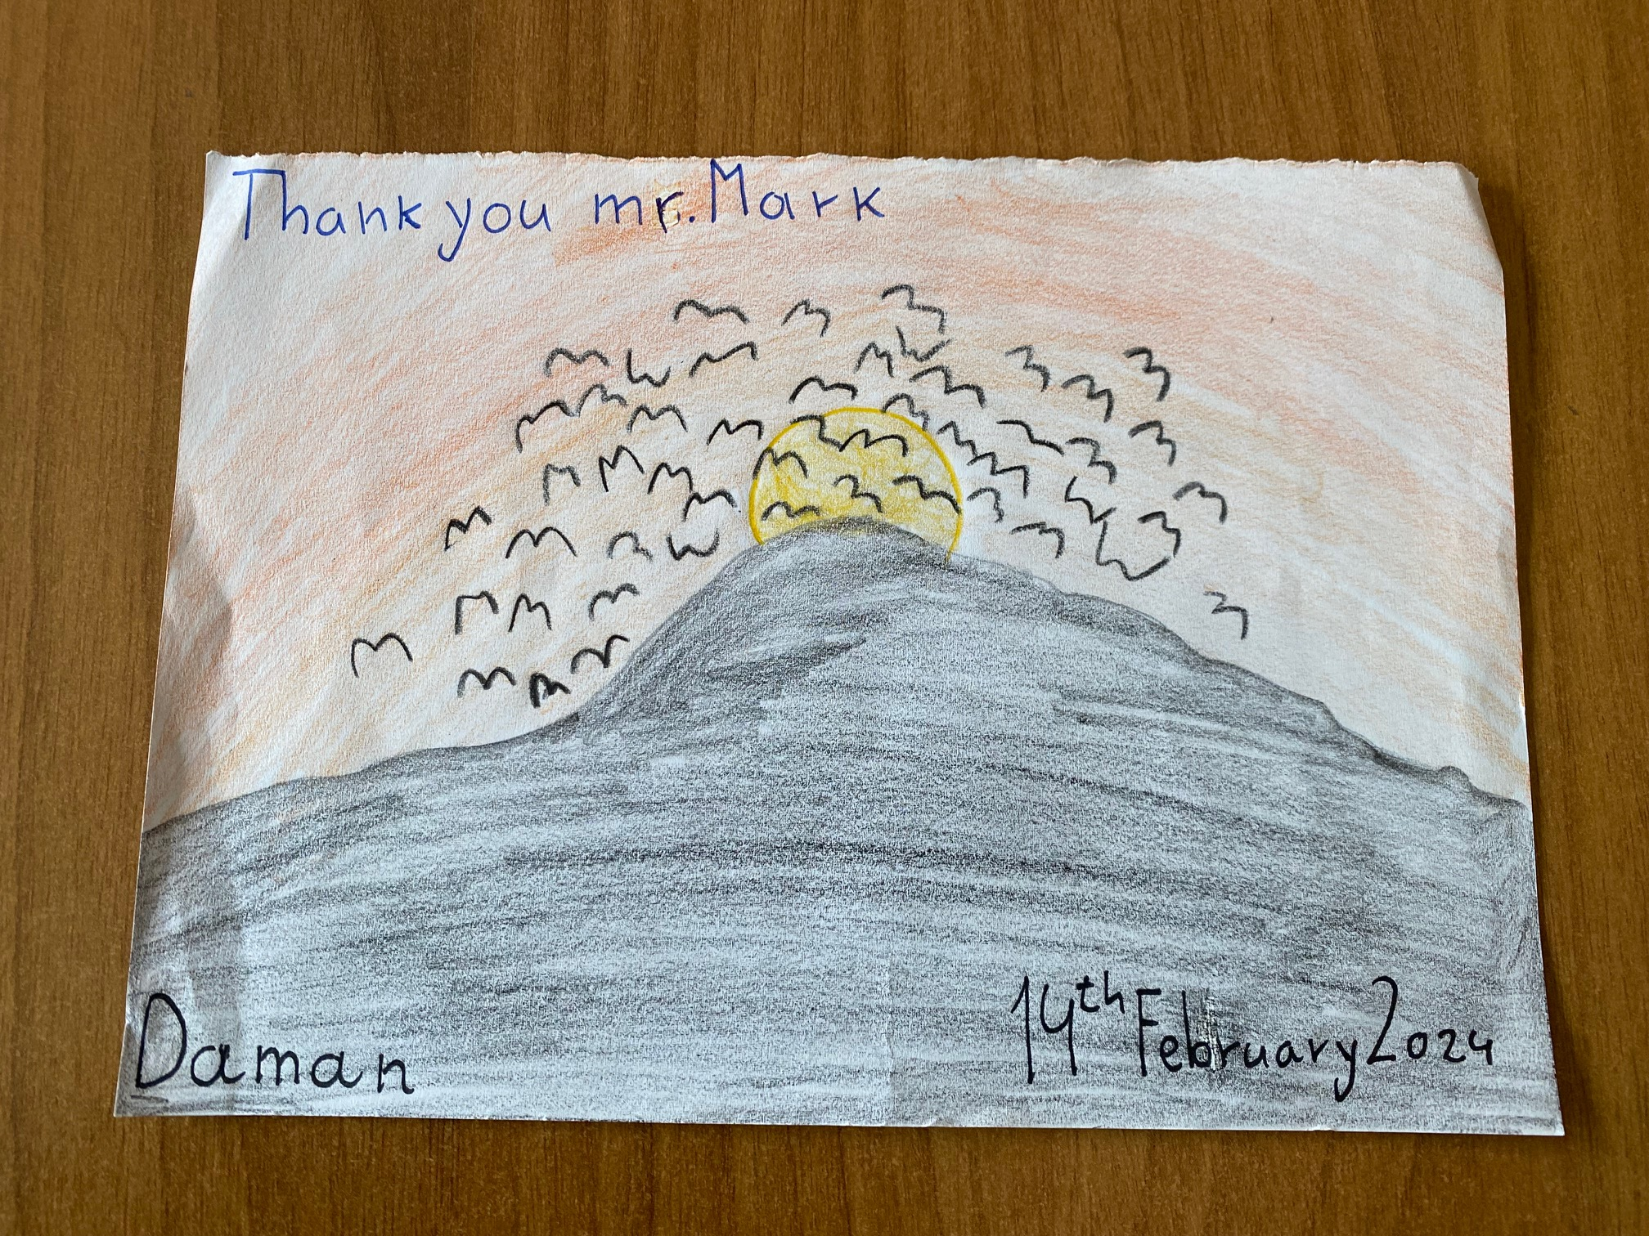

Slide 20
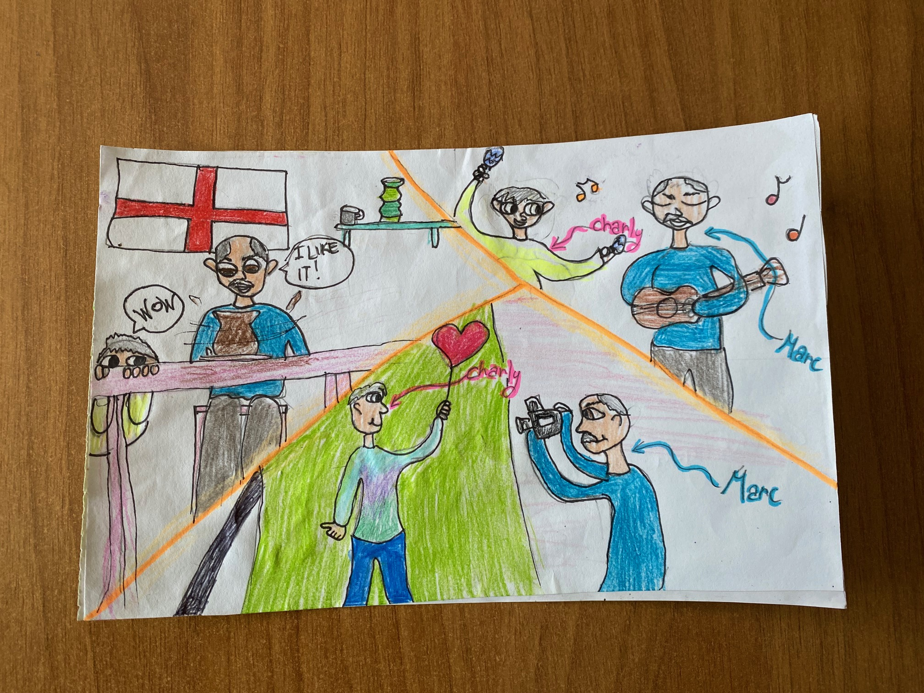

Slide 21
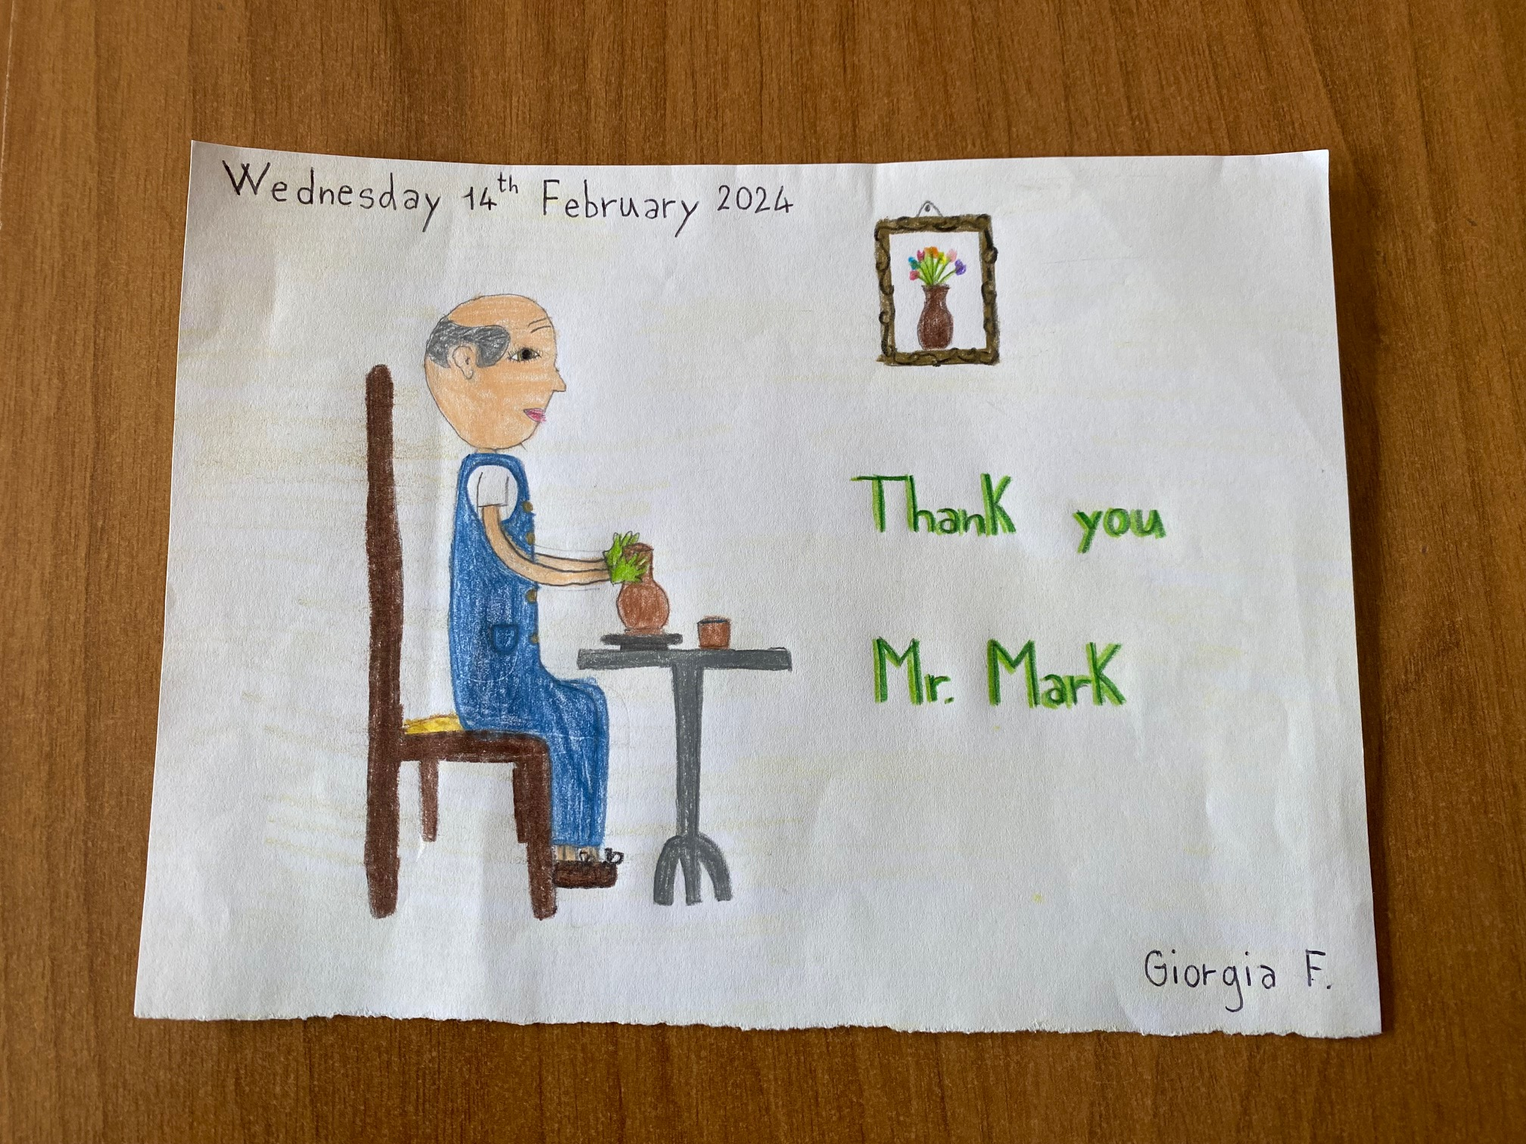

Slide 22
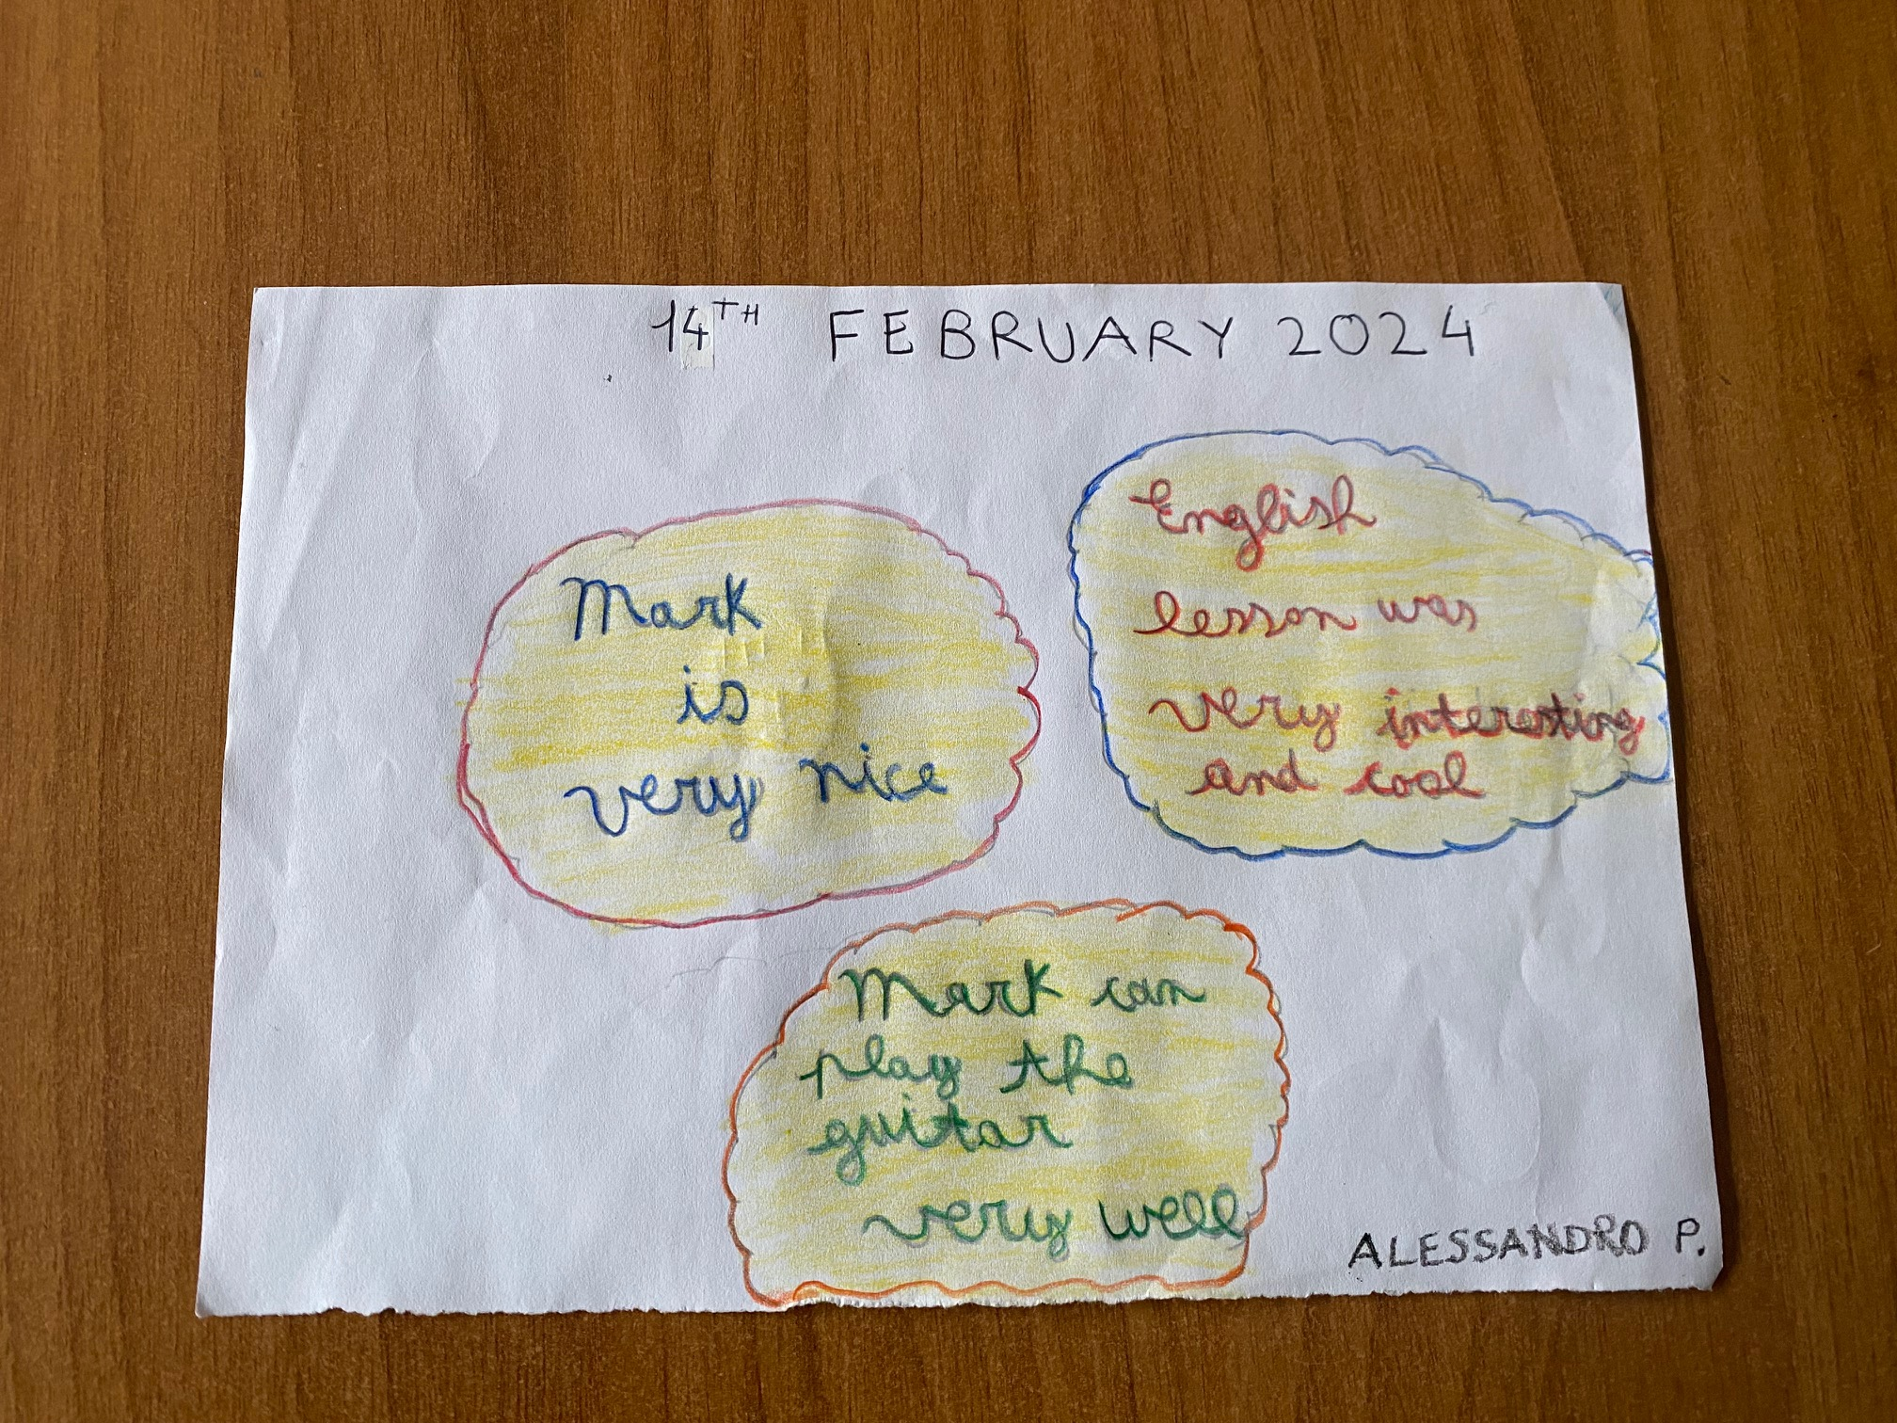

Slide 23
CLASSES: V A/V B SISSA - V C TRECASALI
TEACHERS: ELENA VIGNALI - TIZIANA TRIDENTE

